Slide 1
A3.aa
Refresh of Week 2
Sabah Ul-Hasan

Slide 2
Zoom Poll
How much time did you spend on HW2? (outside of class time)
<2 hours
2-4 hours
4-6 hours 6+ hours
Notes:
Want to know if you encounter unwelcoming behavior outside or inside classroom

Slide 3
Zoom Poll
HW2 was...
easier for me to navigate than HW1, due to being more comfortable
easier for me to navigate than HW1, due to it being an easier assignment
harder for me to navigate than HW1, but I do feel more comfortable harder for me to navigate than HW1, and I still feel very stressed in this class
Notes:
Want to know if you encounter unwelcoming behavior outside or inside classroom

Slide 4



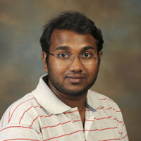

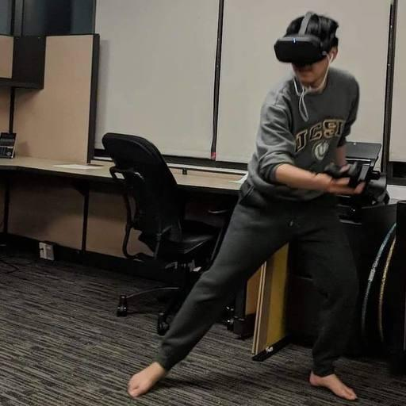


Reach out -- We’re here for you!
Expertise
Mentorship
Professionalism
Communicative
We’re humans, too (as are you!) We’ll be decompressing during non-business hours
Support of you being your healthiest self
Huitian Dao
Karthik Gangavarapu
Shang-Fu
Chen
Andrew Su
Sabah Ul-Hasan

Slide 5
How to create a better self-learning infrastructure?

Slide 6
How to create a better self-learning infrastructure?
I’m in a breakout room… now what?
Code Review (homework)
Groups
Think-Pair-Share
Individual

Slide 7
How to create a better self-learning infrastructure?
I’m in a breakout room… now what?
Code Review (homework)
Identify a common problem you all encountered
https://www.youtube.com/watch?v=a9_0UUUNt-Y

Slide 8
How to create a better self-learning infrastructure?
I’m in a breakout room… now what?
Code Review (homework)
Identify a common problem you all encountered
One person volunteers to walk-through their code
Utilize screen-share
Talk through each step, line-by-line
The less judgement, the more learning
https://www.youtube.com/watch?v=a9_0UUUNt-Y

Slide 9
How to create a better self-learning infrastructure?
I’m in a breakout room… now what?
Code Review (homework)
Identify a common problem you all encountered
One person volunteers to walk-through their code
Utilize screen-share
Talk through each step, line-by-line
The less judgement, the more learning
Take notes on how each of your understanding of that code (and question) is now improved
https://www.youtube.com/watch?v=a9_0UUUNt-Y

Slide 10
How to create a better self-learning infrastructure?
I’m in a breakout room… now what?
Code Review (homework)
Groups
Similar concepts as code review, but may be more discussion-oriented depending on the question(s)

Slide 11
How to create a better self-learning infrastructure?
I’m in a breakout room… now what?
Code Review (homework)
Groups
Similar concepts as code review, but may be more discussion-oriented depending on the question(s)
Remember to take a step back, or forward
If you’re generally “a talker”, step back
If you’re general “a listener”, step forward

Slide 12
How to create a better self-learning infrastructure?
I’m in a breakout room… now what?
Code Review (homework)
Groups
Similar concepts as code review, but may be more discussion-oriented depending on the question(s)
Remember to take a step back, or forward
If you’re generally “a talker”, step back
If you’re general “a listener”, step forward
If you feel ahead, teach others what you’ve learned
If you’re unsure, answer questions
The less judgement, the more learning

Slide 13
How to create a better self-learning infrastructure?
I’m in a breakout room… now what?
Code Review (homework)
Groups
Think-Pair-Share
You may intentionally be paired in a teacher-learner dynamic (and you will find yourself at either end throughout the class)

Slide 14
How to create a better self-learning infrastructure?
I’m in a breakout room… now what?
Code Review (homework)
Groups
Think-Pair-Share
You may intentionally be paired in a teacher-learner dynamic (and you will find yourself at either end throughout the class)
You may intentionally be paired with someone at the same learning stage for deeper discussion

Slide 15
How to create a better self-learning infrastructure?
I’m in a breakout room… now what?
Code Review (homework)
Groups
Think-Pair-Share
Individual
This means we think you’re ready to try it out on your own!
We expect you to ‘get stuck’ and overcome it, this is part of the learning process

Slide 16
How to create a better self-learning infrastructure?
I’m in a breakout room… now what?
Code Review (homework)
Groups
Think-Pair-Share
Individual
This means we think you’re ready to try it out on your own!
We expect you to ‘get stuck’ and overcome it, this is part of the learning process
After you’ve attempted but continue to experience hurdles, this is a great time to reach out to TAs and instructors help

Slide 17
Why do we do this?
I’m in a breakout room… now what?
Code Review (homework)
Groups
Think-Pair-Share
Individual

Slide 18
Because we’re lazy 😎
I’m in a breakout room… now what?
Code Review (homework)
Groups
Think-Pair-Share
Individual

Slide 19
Because we’re lazy 😎 active learning is effective
I’m in a breakout room… now what?
Code Review (homework)
Groups
Think-Pair-Share
Individual
We can talk your ears off for 1.5 hours (which is difficult for anyone to pay attention, let-alone on Zoom) or
we can give you exercises in real time to solidify knowledge we teach
https://iubmb.onlinelibrary.wiley.com/doi/full/10.1002/bmb.21413

Slide 20
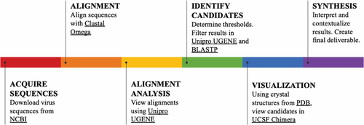
Because we’re lazy 😎 active learning is effective
https://iubmb.onlinelibrary.wiley.com/doi/full/10.1002/bmb.21413

Slide 21
How to create a better self-learning infrastructure?
I’m in a breakout room… now what?
I have a question… now what?

Slide 22
A slight (but final) adjustment on Slack RE participation

Slide 23

Your first time learning in a pandemic, our first time teaching

Slide 24
A slight (but final) adjustment on Slack
I have a question… now what?
2.5 pts per class, graded prior to next class
Can be [one] question or answer, more are welcome of course
Intention: To practice your understanding

Slide 25
A slight (but final) adjustment on Slack
I have a question… now what?
2.5 pts per class, graded prior to next class
Can be [one] question or answer, more are welcome of course
Intention: To practice your understanding
To help with clutter and also make topics easier to find, post a new question you have as its own post
Check if someone has already asked the question you have
Answer the question if you know the answer

Slide 26
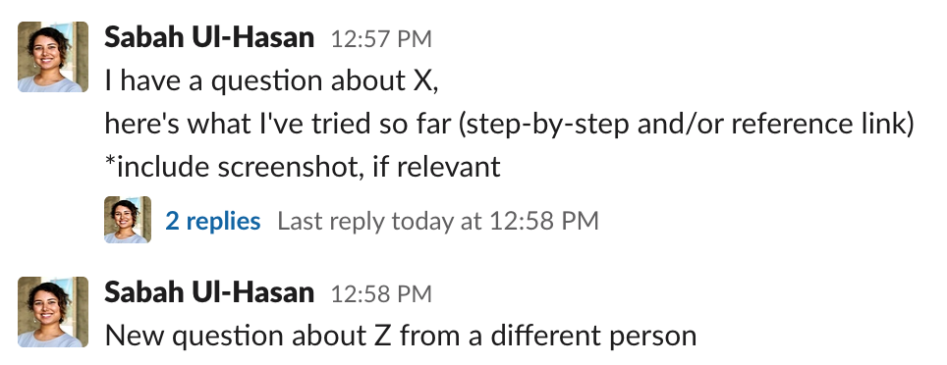
A slight (but final) adjustment on Slack
I have a question… now what?
2.5 pts per class, graded prior to next class
Can be [one] question or answer, more are welcome of course
Intention: To practice your understanding

Slide 27
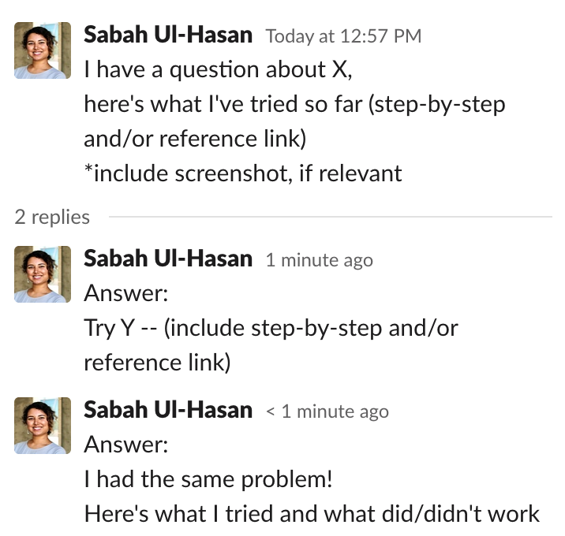
A slight (but final) adjustment on Slack
I have a question… now what?

Slide 28
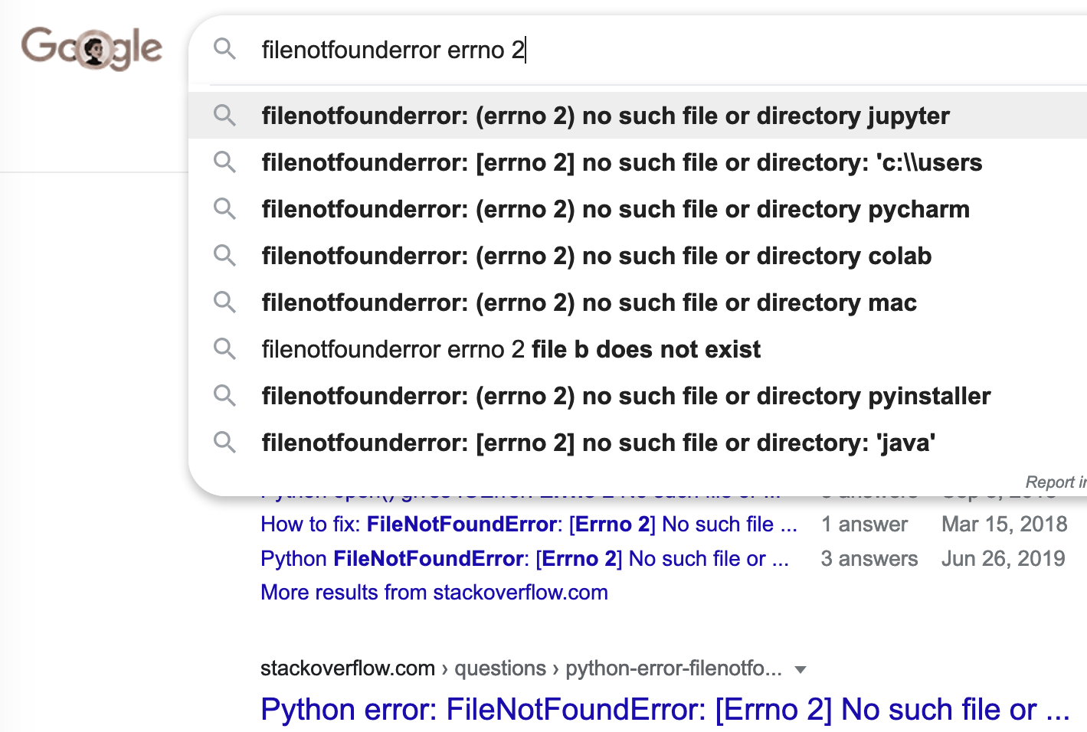
Helpful Sites
I have a question… now what?
https://stackoverflow.com/

Slide 29
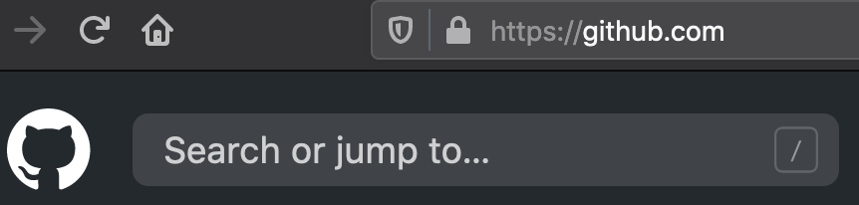
Helpful Sites
I have a question… now what?
https://stackoverflow.com/

Slide 30
How to create a better self-learning infrastructure?
I’m in a breakout room… now what?
I have a question… now what?
Zoom study group (self-organized) for any time 🎉 Meeting ID: 944 7012 5565 Passcode: AbcbStudy

Slide 31
Zoom Poll
Assessment of Bash (Weeks 1-2)
Notes:
Want to know if you encounter unwelcoming behavior outside or inside classroom

Slide 32
Question 1
I can run code in a markdown cell.
True False
Question 2
%%bash Can only be used as syntax in terminal Can only be used as syntax in jupyter notebook Can be used as syntax in either Not sure
Question 3 (select all that apply)
The command, awk {print$3} artists.txt is missing a pattern, but will still run needs a pattern, depending on desired output needs a pattern to run
Notes:
Want to know if you encounter unwelcoming behavior outside or inside classroom

Slide 33
HW 1 -- Common Items
12 points total: 10 task + 1 code + 1 written
10 points max possible
Key is on Github repo
Make sure to submit prior to class (8 AM PST on Tuesdays)
Make sure you stop running after you’ve saved (speed, demo)
Make sure blocks of code are in Code cells > Markdown (demo)
If you’re unsure about what a question is asking, clarify in Slack

Slide 34
HW 1 -- Common Items
12 points total: 10 task + 1 code + 1 written
10 points max possible
Key is on Github repo

Slide 35
Resources
General Bash tutorials and exercises
Huitian’s exercises from Fall 2018
https://www.learnshell.org/
https://www.gnu.org/software/bash/manual/bash.pdf
http://index-of.co.uk/Programming/Bash_Guide_for_Beginners_2nd_Ed.pdf
https://theswissbay.ch/pdf/Gentoomen%20Library/Programming/Bash/O%27Reilly%20bash%20CookBook.pdf
More on Bash commands
https://seankross.com/the-unix-workbench/command-line-basics.html#hello-terminal
https://mywiki.wooledge.org/BashGuide/SpecialCharacters
The dangers of rm command, an others
Renaming files
awk
Debugging: https://regex101.com/
Github: https://guides.github.com/activities/hello-world/

Slide 36
HW 2
Key,
and troubleshooting

Slide 37
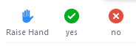
Code Review
[ ] Open HW 3, complete A3.aa tasks in groups of 3
[ ] If you were a TA, what suggestion would you recommend?

Slide 38
A3.ab Intro to R
Sabah Ul-Hasan
Credit: Huitian Dao

Slide 39
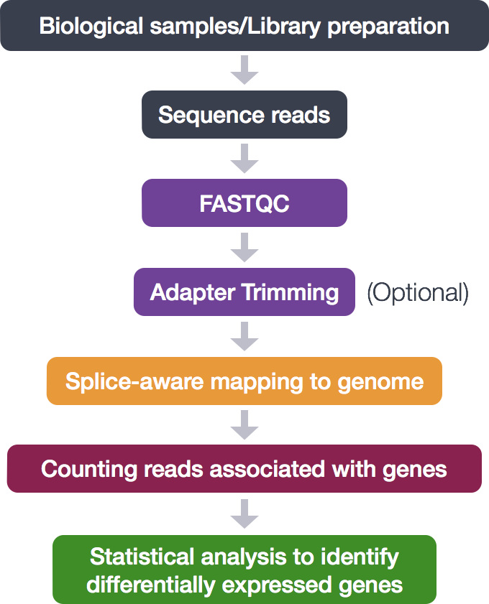
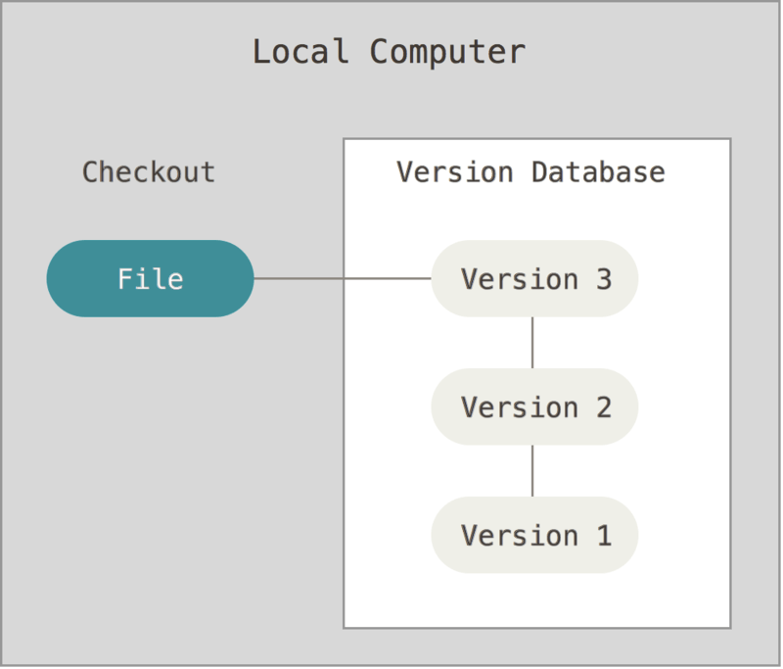
Why do we care about any of this? + Git
}
Bash
R
https://git-scm.com/book/en/v2/Getting-Started-About-Version-Control
Github
https://hbctraining.github.io/Intro-to-rnaseq-hpc-O2/lessons/07_automating_workflow.html
https://pubmed.ncbi.nlm.nih.gov/29624415/

Slide 40

A Brief Histo-R-y

Slide 41
A Brief Histo-R-y
Started as ‘S’ in 1976
In 2000, beta version released
Primarily for statistical computing

Slide 42
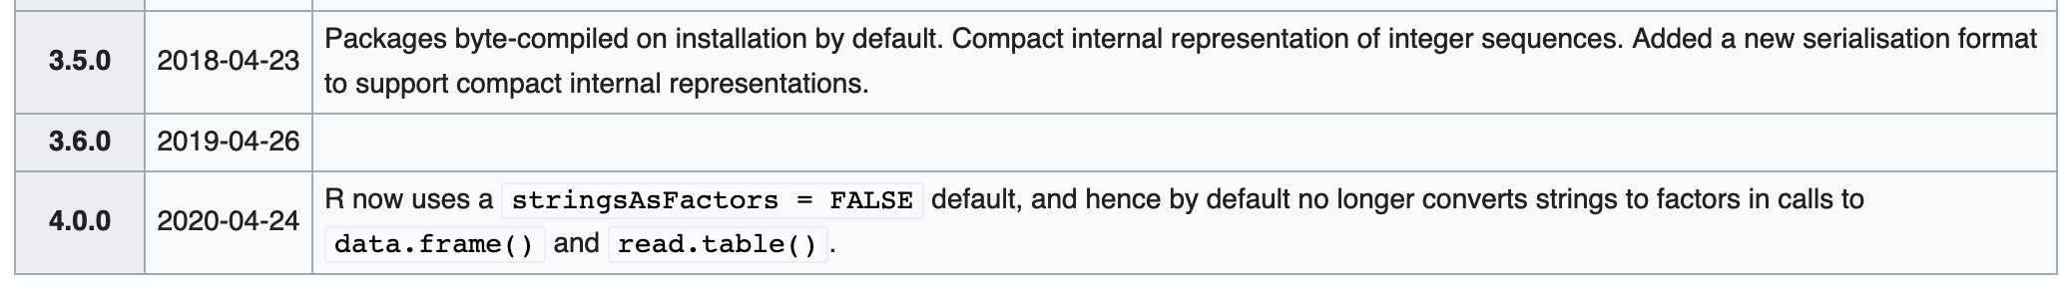
A Brief Histo-R-y
Started as ‘S’ in 1976
In 2000, beta version released
Primarily for statistical computing Updates since this class was last offered (Fall 2018)
https://en.wikipedia.org/wiki/R_(programming_language)

Slide 43
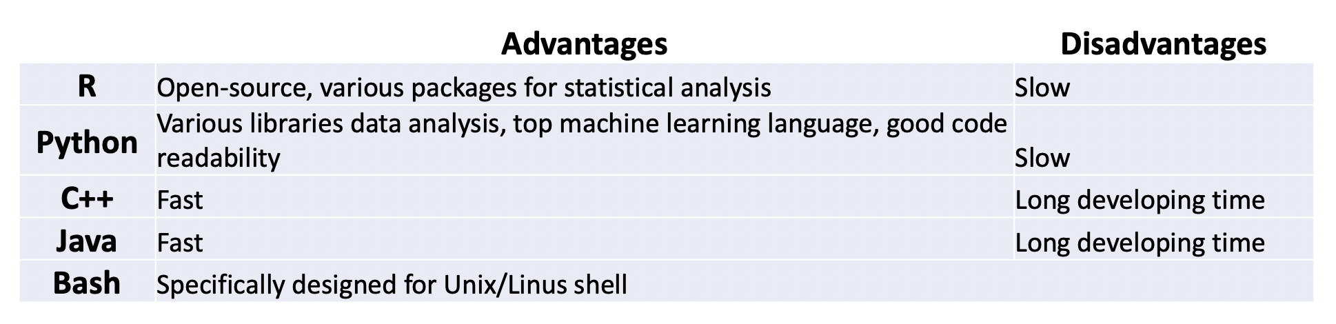
Why R?

Slide 44
Why R?
Becoming faster in usage (RE disadvantage)
Great for visualizing data (ie ggplot2 package) and statistics
Frequently used in academic research: Reproducibility and troubleshooting
Use what makes sense for your lab and research: Maybe R, maybe another
https://www.newgenapps.com/blog/6-reasons-why-choose-r-programming-for-data-science-projects/

Slide 45
R Basics
Helpful tutorials
https://www.tutorialspoint.com/r/index.htm
http://swcarpentry.github.io/r-novice-gapminder/

Slide 46
R Basics
Helpful tutorials
https://www.tutorialspoint.com/r/index.htm
http://swcarpentry.github.io/r-novice-gapminder/
2+3? (demo)

Slide 47
R Basics
Helpful tutorials
https://www.tutorialspoint.com/r/index.htm
http://swcarpentry.github.io/r-novice-gapminder/
2+3? (demo)
pwd?
Working directory | getwd()
Set working directory | setwd()
List files in directory | list.files()
Version check | R.Version()
Get help | help()

Slide 48
R Syntax (demo with 2+3 cnt’d)
Value assignment | <-
Print | print()
Comments | # comments

Slide 49
R Syntax
Data | Example
Character | “a”. “qwe”
Numeric | 2. 3.14
Integer | 2L (L indicates integer)
Logical | TRUE FALSE
Complex | 1+4i

Slide 50
R Data Types (like a .csv, but.. different)
List | An ordered collection of objects. A list allows you to gather a variety of objects.
Vector | A sequence of data elements of same basic type.
Matrices | Elements of the same type arranges in two-dimensional rectangular layout.
Arrays | Like matrices but can store more than 2 dimensions.
Data frames | Like matrices, but different columns can have different modes (csv-like)
Factors | A nominal variable

Slide 51
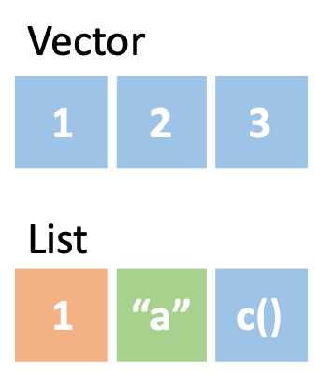
R Data Types (like a .csv, but.. different)
List | An ordered collection of objects. A list allows you to gather a variety of objects.
Vector | A sequence of data elements of same basic type.
Matrices | Elements of the same type arranges in two-dimensional rectangular layout.
Arrays | Like matrices but can store more than 2 dimensions.
Data frames | Like matrices, but different columns can have different modes (csv-like)
Factors | A nominal variable

Slide 52
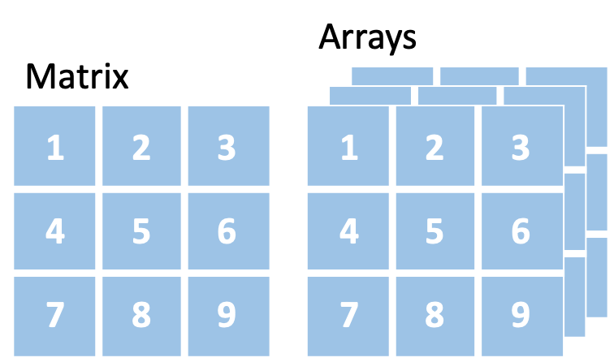
R Data Types (like a .csv, but.. different)
List | An ordered collection of objects. A list allows you to gather a variety of objects.
Vector | A sequence of data elements of same basic type.
Matrices | Elements of the same type arranges in two-dimensional rectangular layout.
Arrays | Like matrices but can store more than 2 dimensions.
Data frames | Like matrices, but different columns can have different modes (csv-like)
Factors | A nominal variable

Slide 53
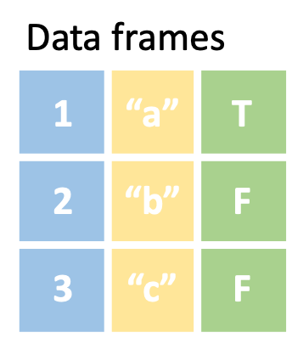
R Data Types (like a .csv, but.. different)
List | An ordered collection of objects. A list allows you to gather a variety of objects.
Vector | A sequence of data elements of same basic type.
Matrices | Elements of the same type arranges in two-dimensional rectangular layout.
Arrays | Like matrices but can store more than 2 dimensions.
Data frames | Like matrices, but different columns can have different modes (csv-like)
Factors | A nominal variable

Slide 54
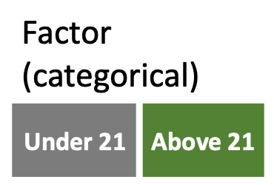
R Data Types (like a .csv, but.. different)
List | An ordered collection of objects. A list allows you to gather a variety of objects.
Vector | A sequence of data elements of same basic type.
Matrices | Elements of the same type arranges in two-dimensional rectangular layout.
Arrays | Like matrices but can store more than 2 dimensions.
Data frames | Like matrices, but different columns can have different modes (csv-like)
Factors | A nominal variable

Slide 55


Why Jupyter > RStudio?

Slide 56
Why Jupyter > RStudio?
Better note-keeping (for learning)
See everything in one place (bash and R exercises)

Slide 57
Why Jupyter > RStudio?
Better note-keeping (for learning)
See everything in one place (bash and R exercises)
One less new software to learn
Prof. Jill Waalen’s Biostats course

Slide 58
Individually,
[ ] Complete A3.bb Q3-4, start Q5
https://rstudio-education.github.io/hopr/r-objects.html

Slide 59
Basic (Base R) Functions for Objects
Type of object | class()
Storage mode | mode()
Names | names()
Structure | str()
Number of elements | length()
Current objects listing | ls()
Remove objects | rm()

Slide 60
Basic Data Operations
Arithmetic operators
+ | addition
- | subtraction
* | multiplication
/ | division
** or ^ | exponentiation
%% | modulus
%/% | integer division
Logical operator
> >= | Greater Greater or equal
< <= | Less Less or equal
== != | Equal to Not equal to
! | NOT
| | OR
& | AND
isTrue() | If … is true

Slide 61
Mathematical Functions
abs() | Absolute value
sqrt() | Square root
ceiling() | Ceiling(3.457) is 4
floor() | Floor(3.457) is 3
trunc() | Trunc(5.99) is 5
round() | Round(3.457, digits=2) is 3.48
signif() | Signif(3.475, digits=2) is 3.5
sin() cos() tan() | Trigonometric functions
log() log10() | Natural logarithm or commom logarithm
exp() | e^

Slide 62
Converting Data Types
From | To | Function
Vector | One longer vector | c(x, y)
Vector | Matrix | cbind(x, y) rbind(x, y)
Vector | Data frame | Data.frame(x, y)
Matrix | Vector | as.vector()
Matrix | Data frame | as.data.frame(mymatrix)
Data frame | matrix | as.matrix()
List | Vector | unlist()
* | Numeric | as.numeric()
* | Character | as.character()

Slide 63
Popular R Packages
Purpose | Package
Learning R | DataScienceR
Bioinformatics | Bioconductor
Graphic display | ggplot2
Graphic annotation | ggrepel
Phylogenetic tree | ggtree
3D visualization | rgl
Heatmap | pheatmap
Data manipulation | dplyr
Single-cell / other large gene expression datasets | clusterExperiment
Pathway analysis | clusterprofiler
Differential analysis | DEseq2

